Slide 1
Computer Vision Interpretability
Making Models Trustworthy

Slide 2
What to Expect
By the end of this talk, you will understand
Why do we need Model Interpretability ?
What is model Interpretability ?
Types/Stages in improving model Interpretability ?
How to improve model accuracy using Interpretability ?
Experiments with model Interpretability
Toolkits for CV interpretability : Torch vision, Boilerplate codes in TF & Pytorch
Notes:
In the field of Deep Learning based Computer Vision so much has been accomplished. We have the liberty to pick one of the so many pretrained models and finetune to accomplish the task in hand.
Mostly, we judge a model based on accuracy, precison, recall, IOU etc . But it does not tell why a model classified an image as a cat instead of dog.
So why do we need to know that! –
Primarily, when things go wrong somebody has to fix it. Deeper understanding gives better debugging toolkit.
Additionally, it can help us build reliable accurate faster smaller models.
resist adversial attacks
Out of domain data can be identified
Domains such as medical diagnosis where explanation is necessary will need it
And who knows even new line of architectures may emerge.
I will be explaining and showing saliency maps, and unit visualizations. Which are good tools to understand models locally and globally.
And most importantly, will also show ways to build better models using all this techniques.

Slide 3
Why Interpretability
Most of the models are judged based on accuracy metrics such as precision and recall of validation and test set.
While it is important to note the model accuracy scores, we have no way to check why the model responded the way it did.
Deploying any real-world safety-critical applications without understanding the models in depth can have unintended side effects.
Model Interpretability gives us the ability to understand the reasoning behind the model’s decision.

Slide 4
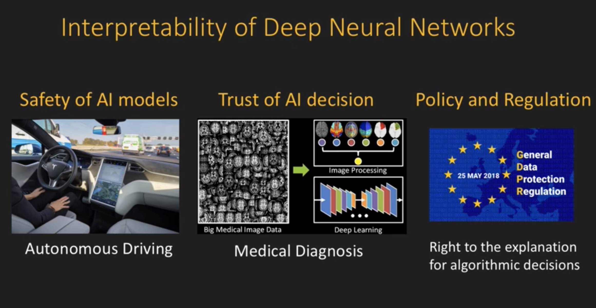

Slide 5
What is model Interpretability

Slide 6
Stages of Model Interpretability

Slide 7
Common Misunderstandings

Slide 8
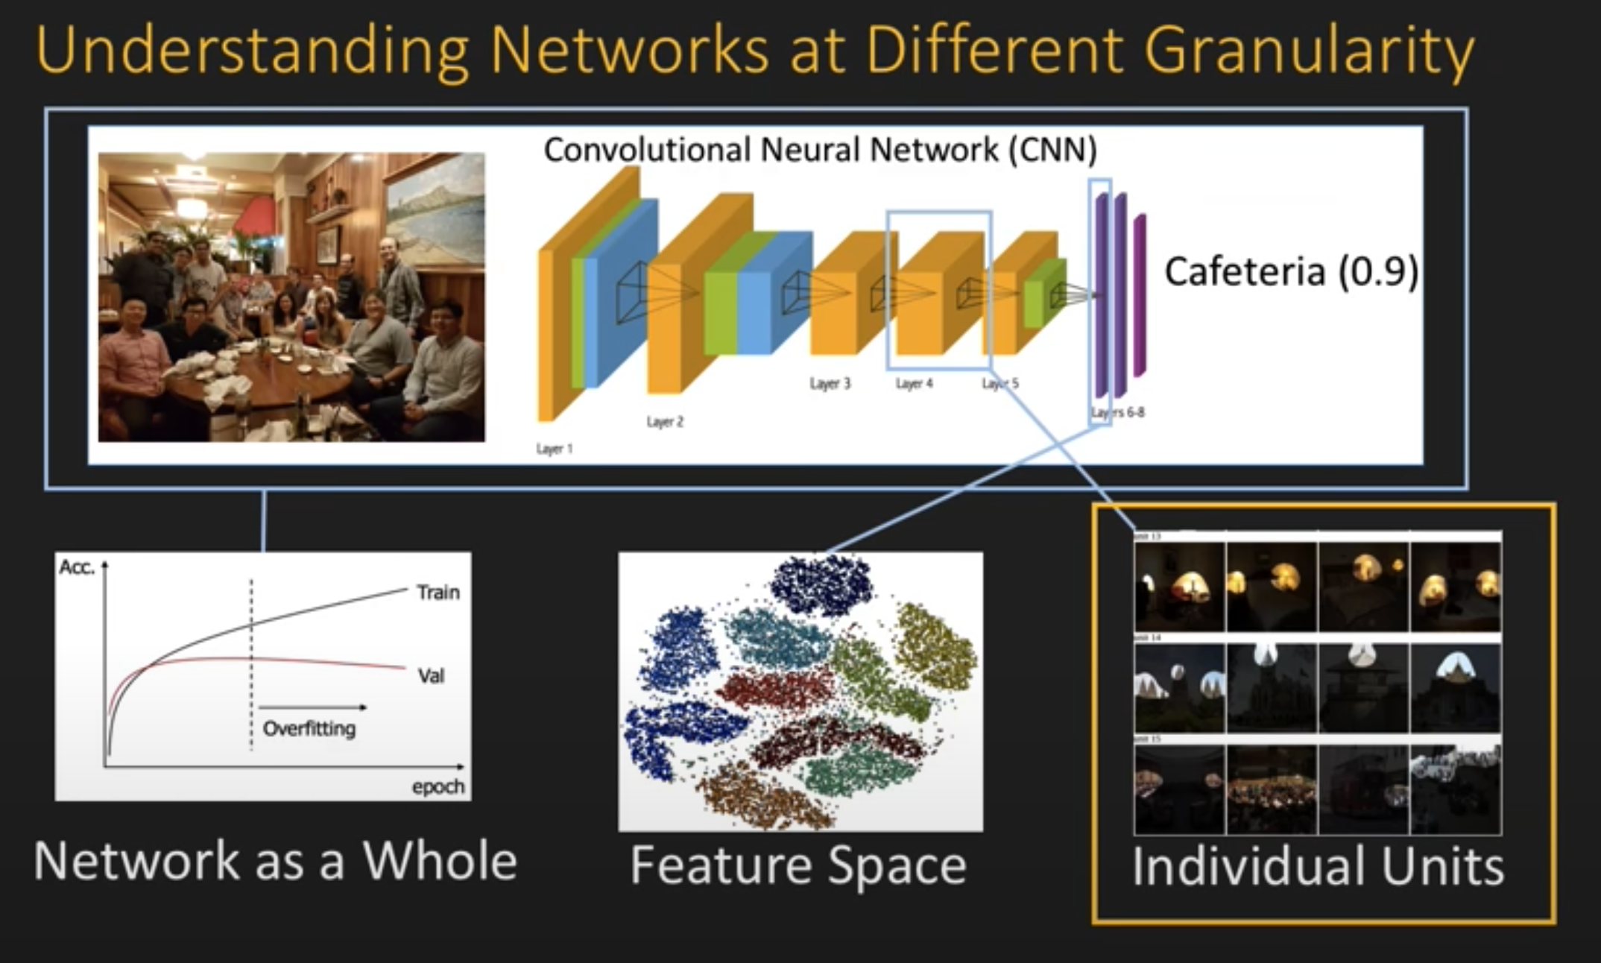
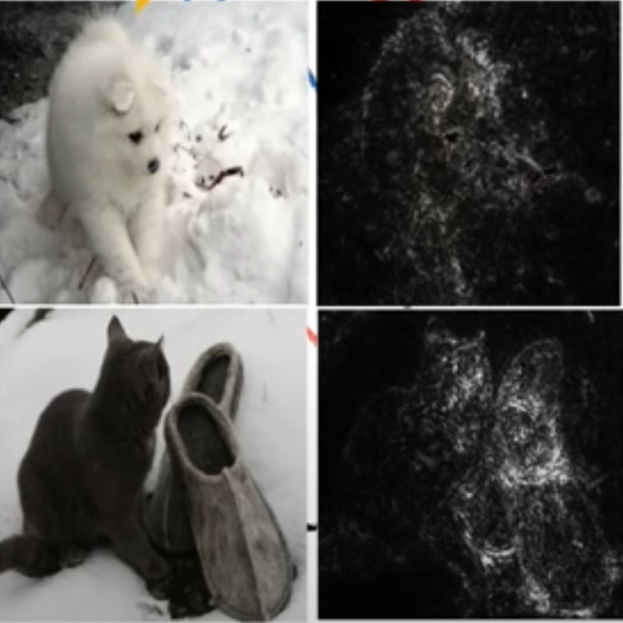
CV Interpretability techniques - Saliency

Slide 9
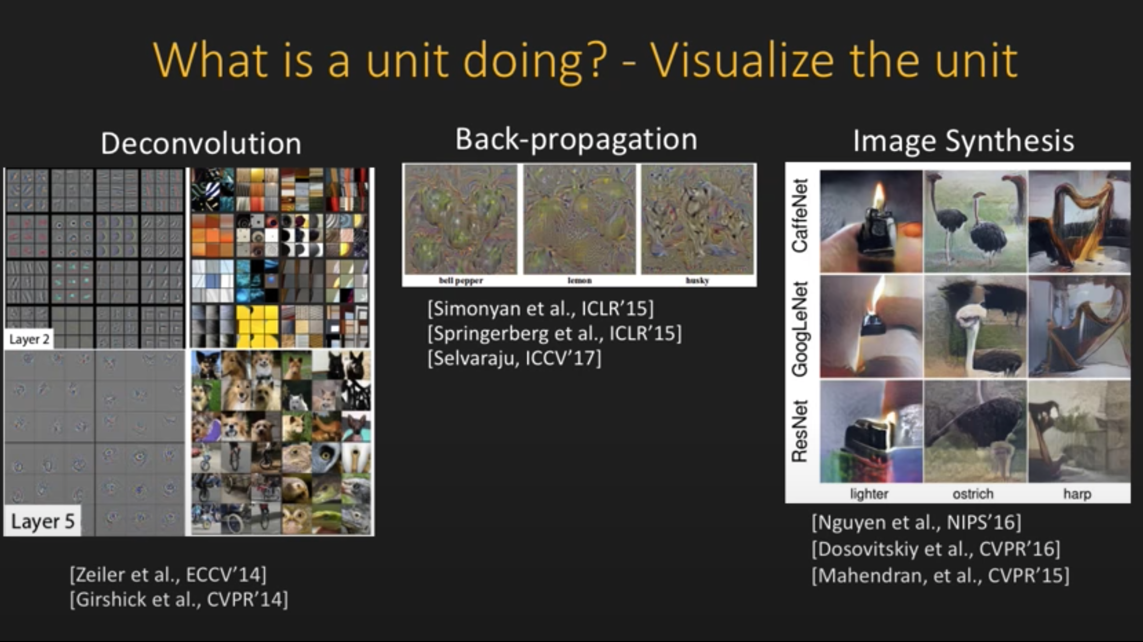
CV Interpretability techniques – Unitwise ananlysis

Slide 10
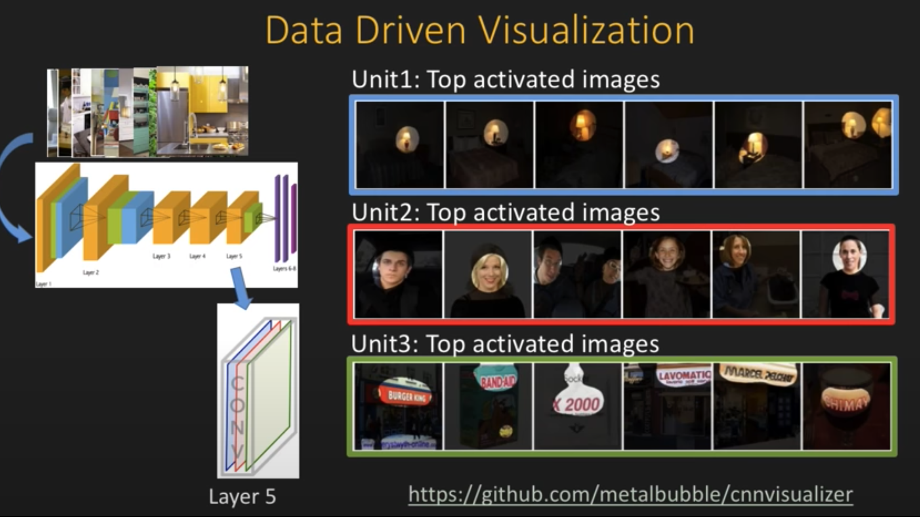
CV Interpretability techniques - visualization

Slide 11
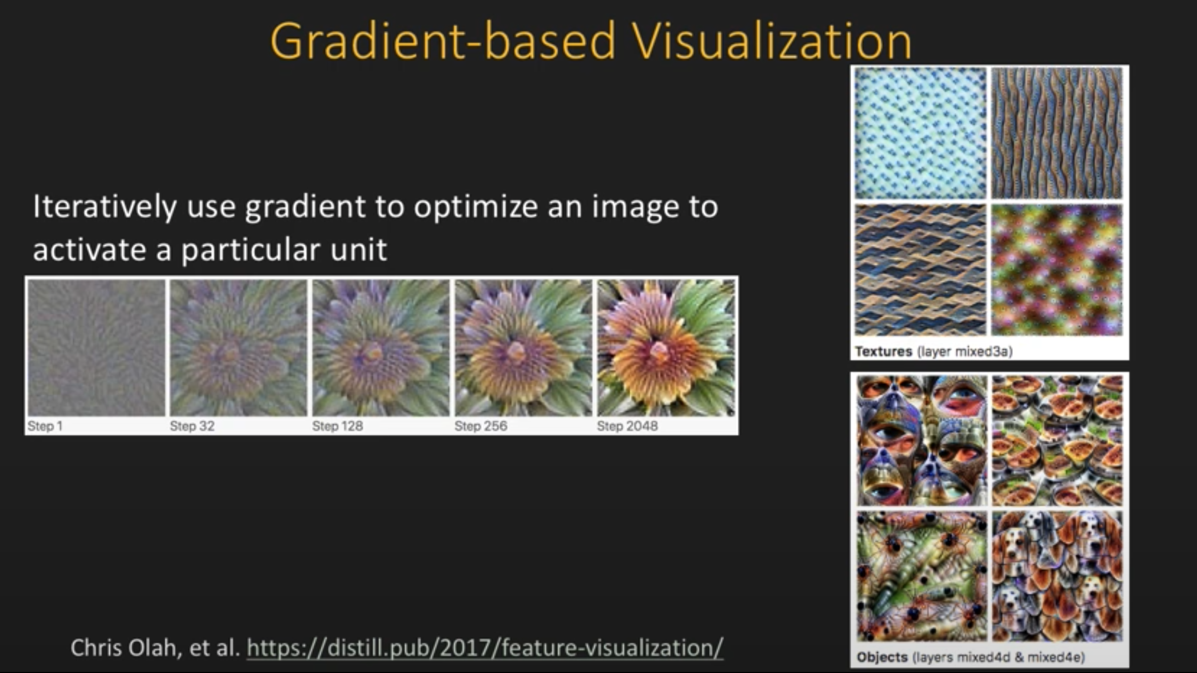
CV Interpretability techniques - visualization

Slide 12
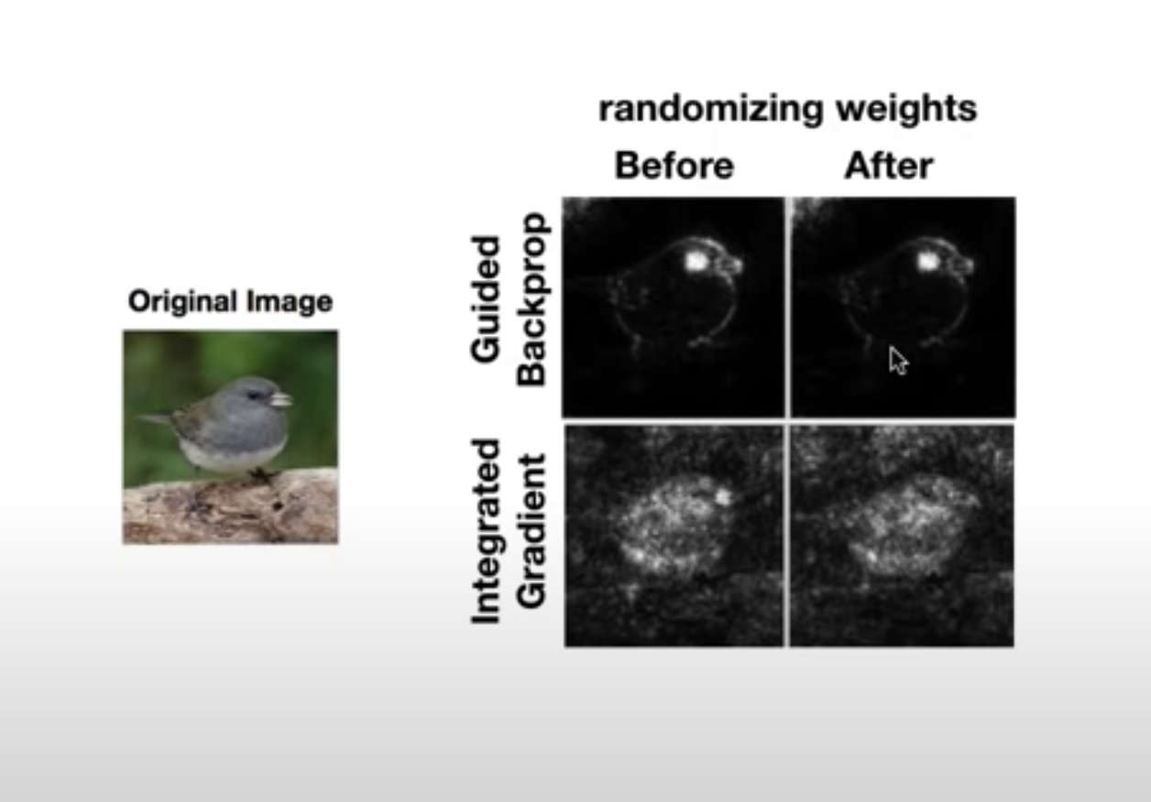
Experiments

Slide 13
Good Practices and ways to improve Model

Slide 14
Python in Use
Python + Jupyter notebooks comes in handy to generate and visualize saliency maps and intra model layers.
Generating special saliency map yard sticks and using those yard sticks to validate future model roll-outs is possible with the help of python pipeline.
It is easy to store the model evaluation results in Python data frame and analyze the reason for failure.
All of the functionalities in the proposed idea greatly rely on packages available in Python. The Pachyderm pipeline uses packages such as tensorwatch, tensorflow, pytorch, auto-sklerarn, hyperopt, Transformers, Tf-hub packages etc

Slide 15
Thank You!

